Slide 1



PACE ASSEMBLY TOOLS
INTO THE FIELD OF CONSULTANCY SERVICES , ASSEMBLY TOOLS SOLUTION AND COST MANAGEMANET

Slide 2


OBJECTIVE
3 T
= Cost Management
Tooling +Training + Team Work

Slide 3

PACE ASSEMBLY TOOLS
Consultancy + Concept = Solution

Slide 4



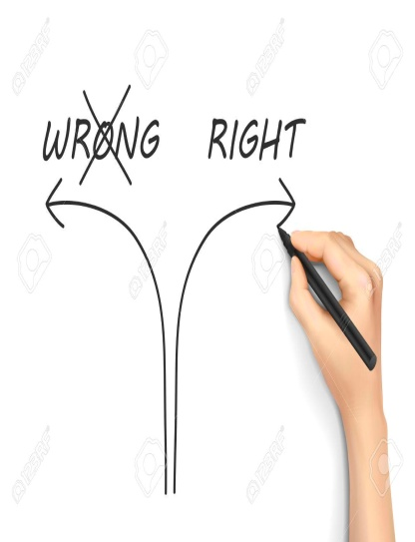
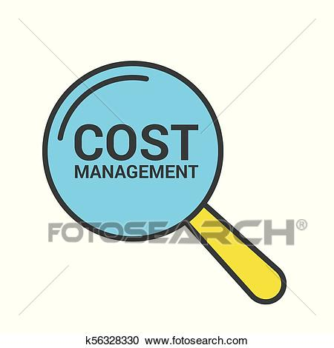
What you are thinking about cost management ?
Are you thinking ??

Slide 5
PACE ASSEMBLY TOOLS
Part Distortion
TARGET TORQUE
FINAL
Torque
TORQUE LOSS
DUE TO UNEVEN
CLAMPLOAD
DISTRIBUTION
TARGET
(SEATING TORQUE)
Time
CONSULTANCY ON BOLTING SOLUTION

Slide 6
LCA
PERQ FACTOR
TPM
CPC
Cost Management

Slide 7









PAT GLOBAL BRAND BASKETS
PAT BRANDS

Slide 8
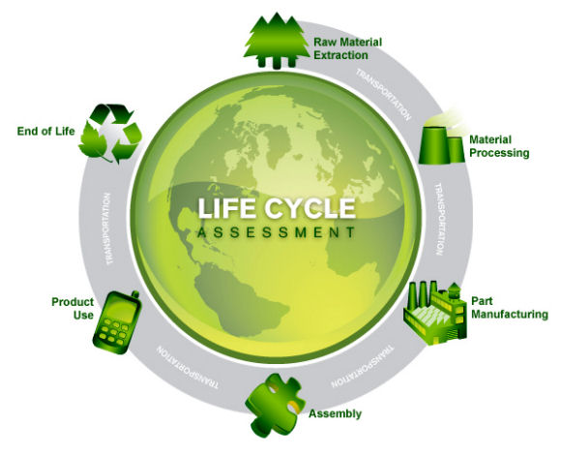
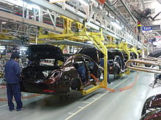
LIFE CYCLE ASSESMENT
WTL

Slide 9
WE DO --- LIFE CYCLE ASSESMENT
PERQ FACTOR ANALYSIS AND OUTCOME
Applicable Tools On application | P Productivity | E Ergonomy | R Reliability | Q Quality | Out come | Remarks
IMPACT | Y | Y | N | N | Not conform to 4.0 | Draws and waste lots of Air , which is very costly
PULSE | Y | Y | N | N | Not conform to 4.0 | Draws and waste lots of Air , which is very costly. Moreover recurring maintenance cost.
IMPACT with Pokyoka | Y | Y | Y | N | Not conform to 4.0 | Very good in super soft joint
Pulse with Pokyoka | Y | Y | Y | N | Not conform to 4.0 | Good in hard joint
Angle Pneu cluch tool | N | N | Y | N | Not conform to 4.0 | Raction is an issue
Direct drive Pneu w/o transducer | N | N | Y | N | Not conform to 4.0 | Reaction is there
Direct drive with transducer PTS | N | N | Y | Y | Not conform to 4.0 | Higher life time and low life cycle cost
Battery Clutch w/o transducer | Y | Y | N | N | Not conform to 4.0 | High maintenance
Battery impact | Y | Y | N | N | Not conform to 4.0 | High maintenance
DC Battery tool with tranducer and wi -fi | N | N | Y | Y | Conform to 4.0 | Latest technology and ease of operation
DC NR | N | N | Y | Y | Conform to 4.0 | Higher life time and low life cycle cost
Pulse with tranducer and masking controller | Y | Y | N | N | Not conform to 4.0 | Lower life , higher maintenance , torquing value as displayed is based on masking alogrithm ,Dynamic torque at out put may be tested with external transducer to understand real time delivery torque.
Cluch elec sc driver | N | Y | N | N | Not conform to 4.0 | For low torque , high maintenance
Cluch DC elec with pokeyokey Sc driver | N | Y | Y | Y | Conform to 4.0 | Low maintenance cost
Commnets : Right tool at right application is a MUST to achieve objective of application NEED

Slide 10
ROI AND LIFE CYCLE COST ARE THE TWO MOST IMPORTANT PART OF LCA
Sr No | Savings heads | Inr | Per period
1 | Saving cost on Energy | 28062 | Inr/Year
2 | Saving cost on Productivity | 21875
3 | Saving cost on Calibration | 4463
4 | Saving cost on Maintenance and spares | 6703
5 | Saving cost on Quality | 9850
6 | Saving costs on Ergonomy | 2800
7 | Yearly savings | 69290
8 | Project life time | 10Years
9 | New solution Investment costs | 430000
10 | Total savings on Project life time | 262898
11 | Payback | 74.47 | Monts
12 | CO 2 reduction | 3 | Tons/year
13 | Reduction of in percentage | -58%
14 | Savings ( 1 Co 2 Ton at cost of 20 E | 55 | EUR/Year
Cost Management

Slide 11
Scope of our consultancy services for assembly tooling and solution
WTL ( Line study ).
Joints study.
Production process study.
Conveyor speed study.
Analysis of different model of product and line balancing activity.
Analysis of PERQ factor of every application and the solution to that.
Select correct tool and solution based on PERQ factor.
Cycle time study and determine MTTR and MTBF.
Communization of tool / solution and optimization.
Best possible ROI factor analysis.
Life cycle cost analysis based on future PPC planning.
Find out best QA process suitable with TACT time.
Defining process of using tools/solution. Dos and Dont’s
Complete selection of tools and solution to be needed.
Defining tools maintenance cycle and the process.
Propose for CPC service to management.
T & C apply

Slide 12
ROI AND LIFE CYCLE COST ARE THE TWO MOST IMPORTANT PART OF LCA
Cost Management

Slide 13

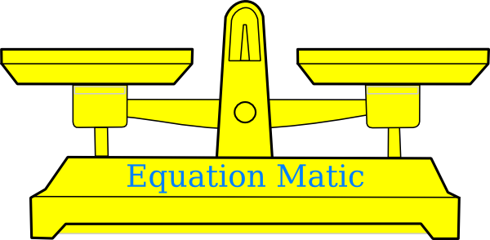

PACE ASSEMBLY TOOLS
CONSULTANCY SERVICE IN ASSEMBLY TOOLING AND SOLUTION
PERQ + CPC
TPM + LCA

Slide 14

PACE ASSEMBLY TOOLS
CONSULTANCY SERVICE AND TRAINING ON SKILL DEVELOPMENT
WE DO
SKILL OPTIMIZATION

Slide 15
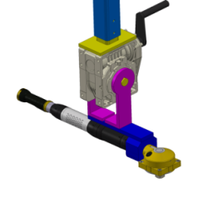
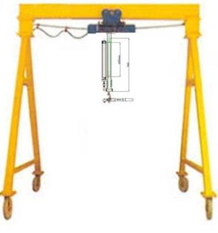
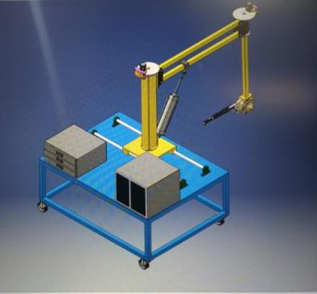
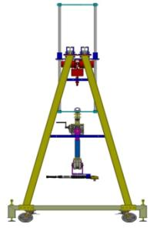
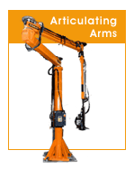
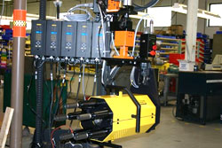
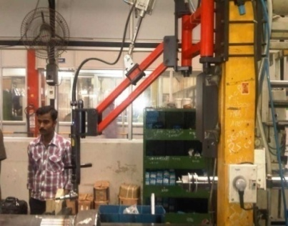
SOLUTION OF TIGHTENING WITH AUTOMATION
Productivity
Reliability
SOLUTION OF TIGHTENING WITH AUTOMATION
Ergonomy
Quality

Slide 16
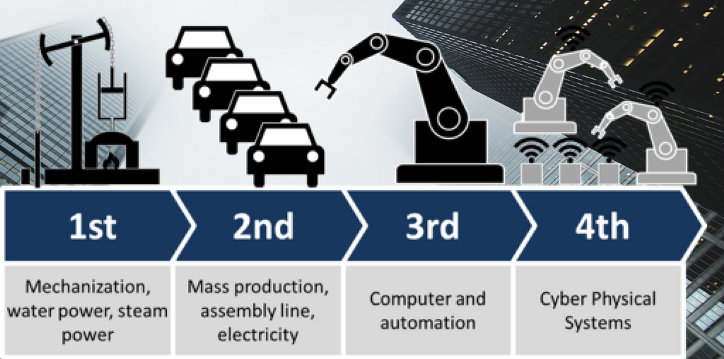
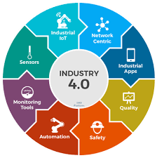
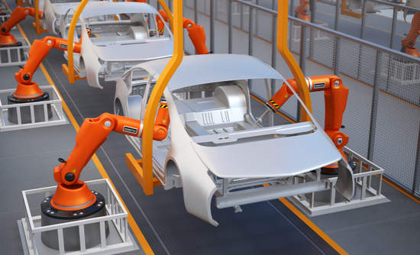

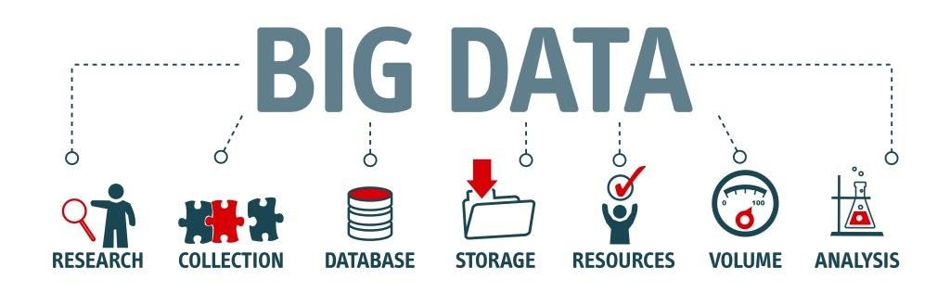

Slide 17
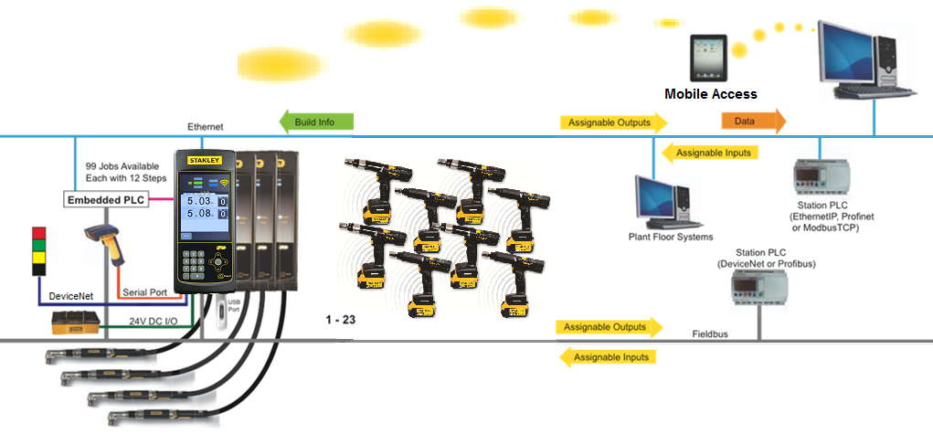
Expert Controller-
Configuration
Tightening Compliance
Notes:
IP : Ingress Protection against solids & liquids

Slide 18
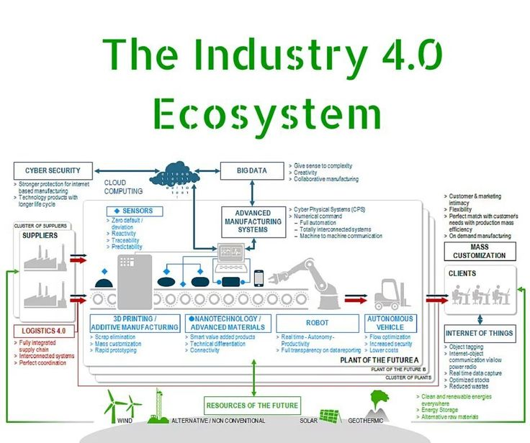
MAPPING THE NITTY GRITTY

Slide 19
PERQ FACTOR + CPC
PERQ will ensure right tool at right application.
While doing PERQ analysis ROI and Life Cycle cost will also be calculated to ensure right quote for solution with a low carbon footprint.
CPC will ensure 98 % uptime for provided solution with strict adherence to TPM system.
4.0 compliance of solution will ensure proper data interlinking/collection and understand ability.
And at the end , right product at right cost will be delivered to customer.
Last and not the least – CPC will ensure customer to get price benefit per aggregate on YOY basis.
Adherence to TPM , focus on PPM to avoid break down , which are always costly.

Slide 20

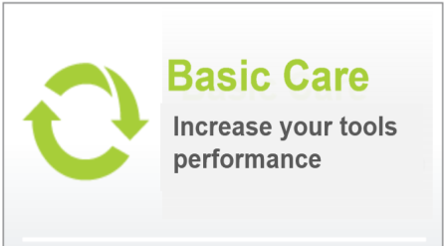

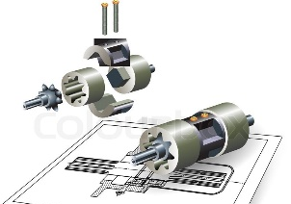


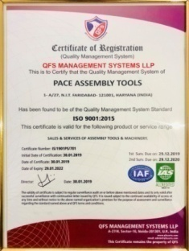
C P C
An innovation for Excellence
Tools’ Services
Technical Support
CPC is a Stable cost that vary in direct proportion to the quantity of products manufactured.
Unlike other costs, which keep varying regardless of output, variable costs are a direct function of production volume, rising whenever production expands and falls whenever it reduces.
Spares Management
Team Training

Slide 21


Benefits of CPC – Tools Availability
Key benefit: Improved UPTIME at reduced cost of tool maintenance
Ensure tools availability and assembly quality
Reduce tools breakdown
Longer life cycle and lower repair costs
Tools upgradation at no extra cost
Tool efficiency
Increased MTBF & Reduced MTTR
Improved production Volumes
Better tools performance
Reduced Total Cost of Ownership

Slide 22
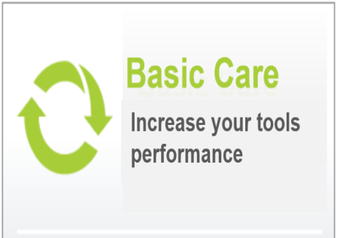
Benefits of CPC – Tool’s Repair And Care Management
One stop solution for all range of tools.
Prevent wastage & no dead inventory.
Implementation of New Technology.
Process driven Maintenance.
Spares & Inventory related failures are eliminated.

Slide 23


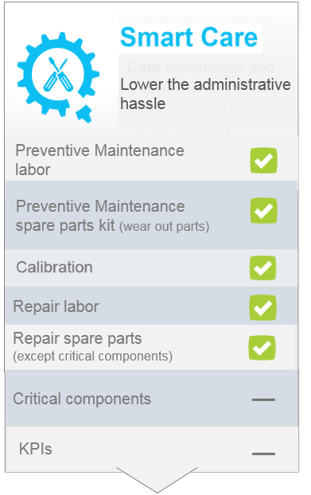
Benefits of CPC
Cut-down Administrative Issues
Comprehensive cost
Spares Management Outsourced
Preventive Maintenance
Administrative issues for tools and spares procurement are passed on to PAT.
Timely Calibration of tools
Budget in control
Need not to worry on lead time for spares supply
Planned and Maintained by PAT.
The delay due to lead time is prevented.
Based on schedule, Budget in scope of PAT

Slide 24
CPC – Commercials & Benefits
CPC Commercials
The formula for calculating total cost is:
Total Cost = Total Quantity of Output x Rate per aggregate
Savings on Inventory carrying Cost 5%
Savings on Men power cost 15%
Savings on Spares & Losses 20%
Price Escalation for next 4 years Fixed 5%
Note:
-Indirect benefits such as reduction in men hour losses & Improved productivity and dead inventory avoided.

Slide 25
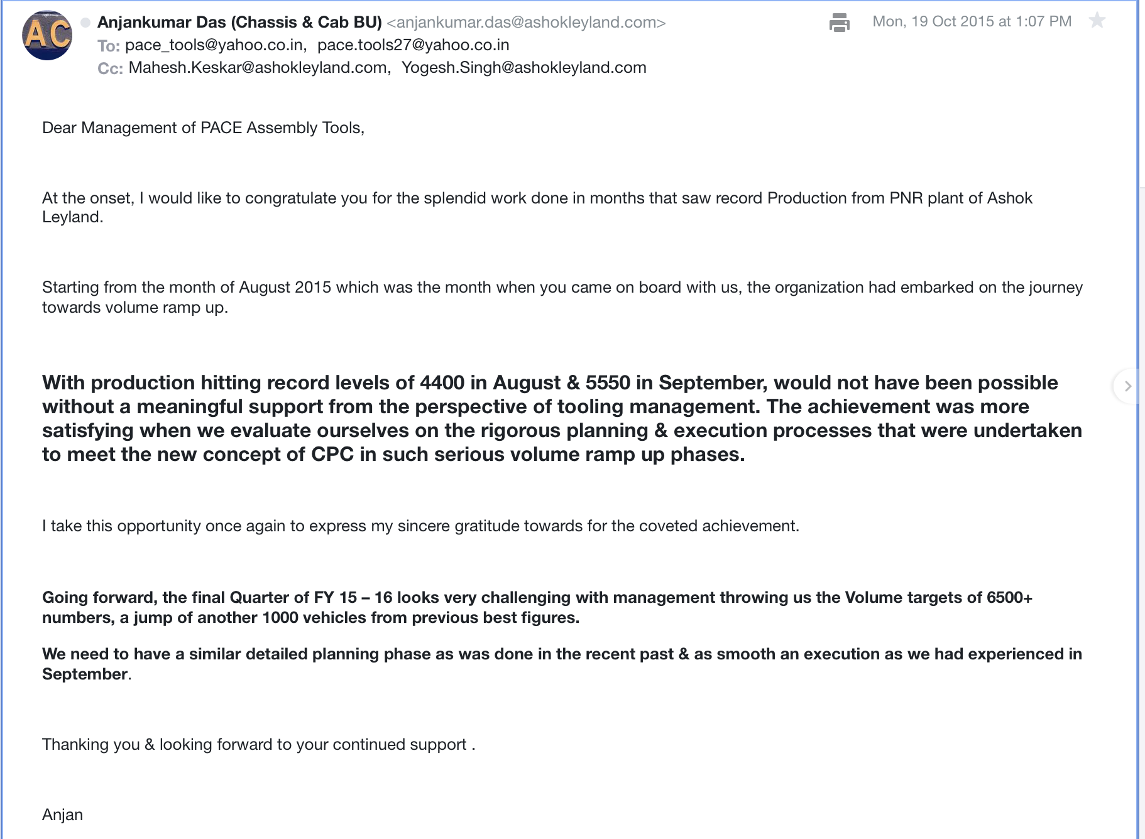
Case study of commercial benefit and customer’s appreciation note from ASHOK LEYLAND
CPC Commercials

Slide 26
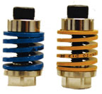
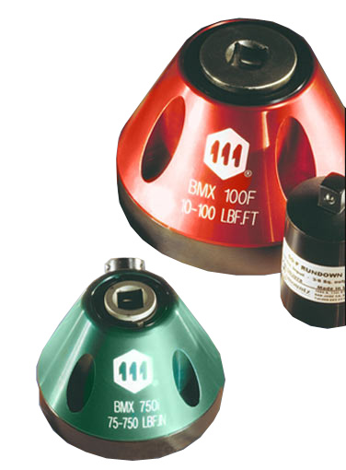
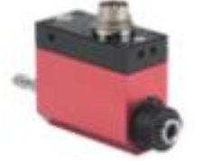
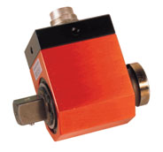

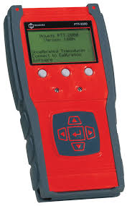
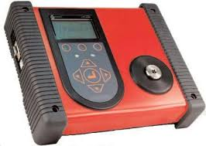
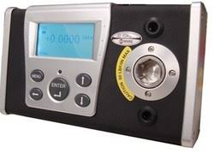
Inhouse Test & Calibration
On Line Transducers
Run down Adapters
BMX Transducers
Torque Testers/Analysers

Slide 27
OUR BASKET OF UNIQUE SERVICES
  Cost Per Component (CPC) for Assembly Tools
  Annual Maintenance Services
  Machine Building with DC Tools
  Articulating Arms & Torque Tubes
  Periodic Preventive Maint. (PPM)
  Training in Tightening Technologies
  Consultancy Services in Proper Tool Selection.
  PERQ factors Support in Assembly Tools

Slide 28

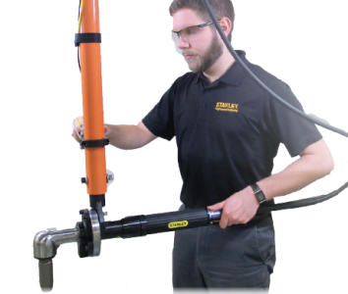


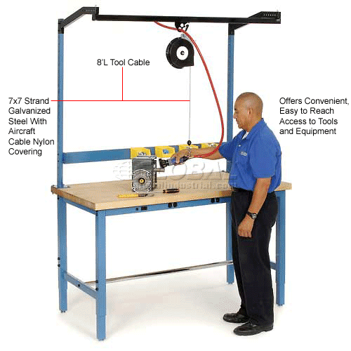
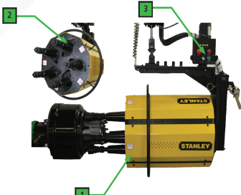
Single WINDOW APPROACH
We encourage automation

Slide 29

PAT AND USER PARTNERSHIP
We ensure : Your tooling part
You concentrate to produce quality end products

Slide 30
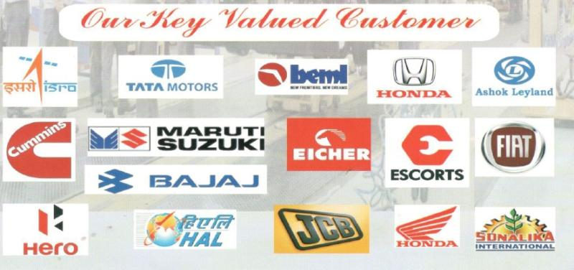
Presence In India
Major customer bench

Slide 31
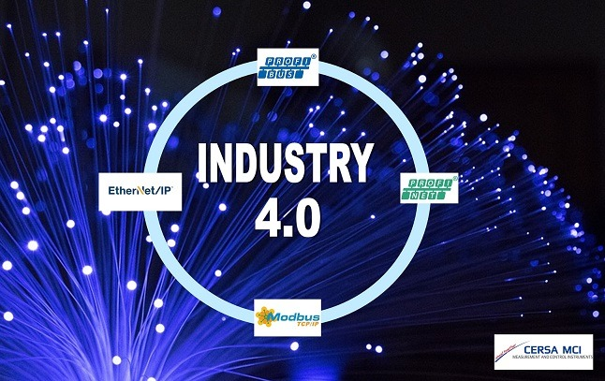
The Era Of 4.0 – Stay Ahead
SKILL
TRAINING
SMART WORK
SMART PRACTICE
LATEST KNOWHOW
ADAPTABILITY
IMPLEMENTATION.

Slide 32
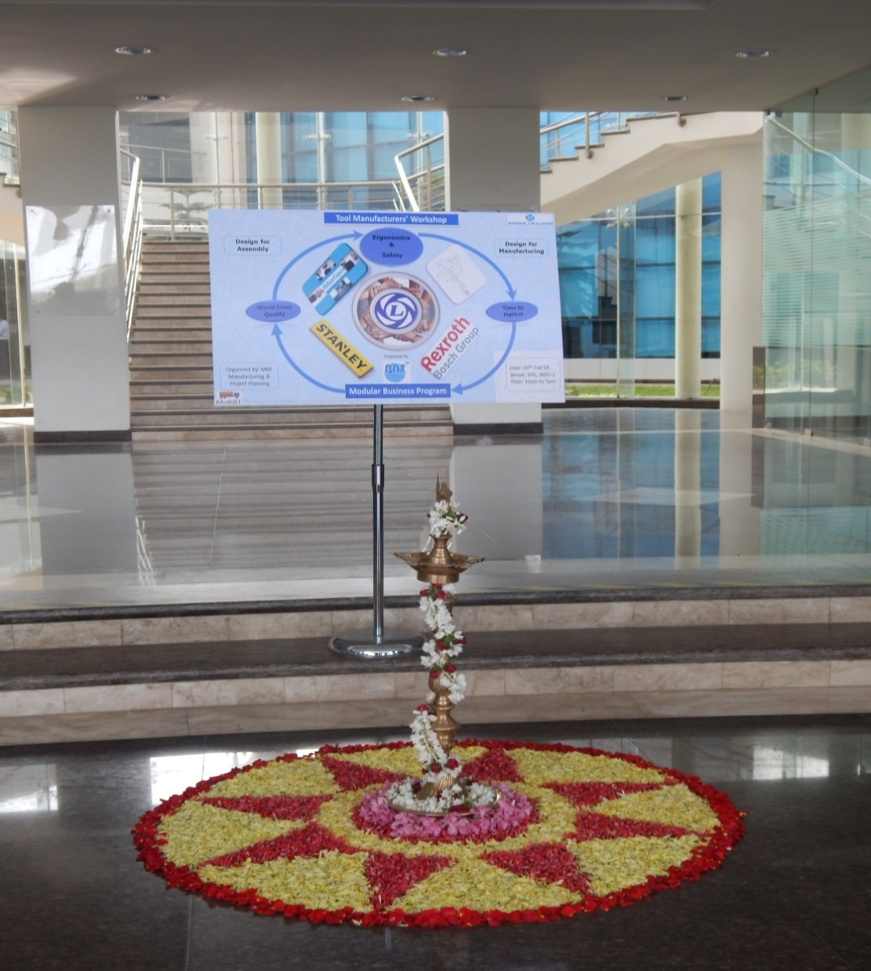
NAME TO RECOGNIZE

Slide 33

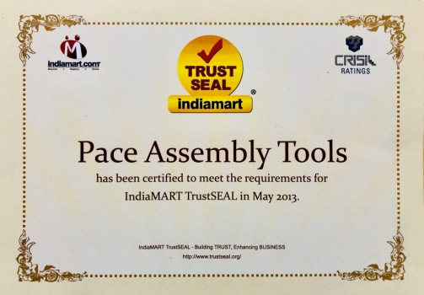
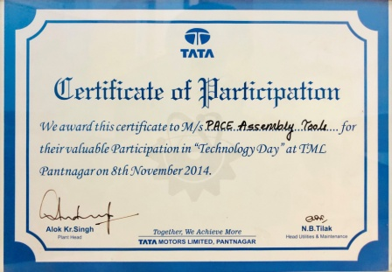
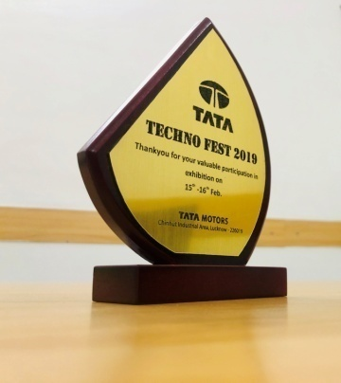
NAME TO RECOGNIZE

Slide 34
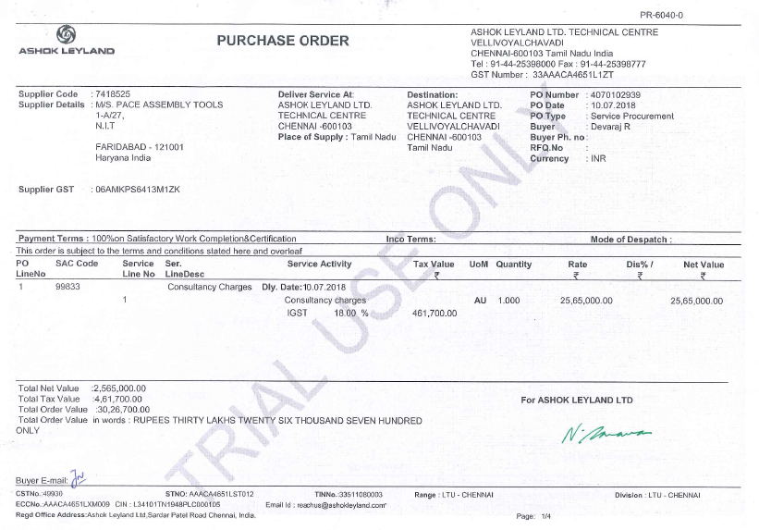
Consultancy For AL MBP project
PAT bagged the most prestigious order from AL for MBP project consultancy

Slide 35


